Slide 1

Data Structures Using C++ 2E
Chapter 8
Queues

Slide 2
Objectives
Learn about queues
Examine various queue operations
Learn how to implement a queue as an array
Learn how to implement a queue as a linked list
Discover queue applications
Become aware of the STL class queue
Data Structures Using C++ 2E

Slide 3
Introduction
Queue data structure
  Elements added at one end (rear), deleted from other end (front)
  First In First Out (FIFO)
  Middle elements inaccessible
Data Structures Using C++ 2E

Slide 4
Queue Operations
Two key operations
  addQueue
  deleteQueue
Additional operations
  initializeQueue, isEmptyQueue, isFullQueue, front, back
queueFront, queueRear pointers
  Keep track of front and rear
Data Structures Using C++ 2E

Slide 5
Implementation of Queues as Arrays
Four member variables
  Array to store queue elements
  Variables queueFront, queueRear
  Variable maxQueueSize
Using queueFront, queueRear to access queue elements
  queueFront: first queue element index
  queueRear: last queue element index
    queueFront changes after each deleteQueue operation
    queueRear changes after each addQueue operation
Data Structures Using C++ 2E

Slide 6
Implementation of Queues as Arrays
(cont’d.)
Execute operation
  addQueue(Queue,'A');
Execute
  addQueue(Queue,'B');
  addQueue(Queue,'C');
Execute
  deleteQueue();
Data Structures Using C++ 2E

Slide 7
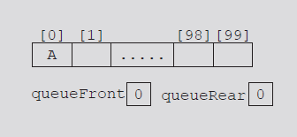
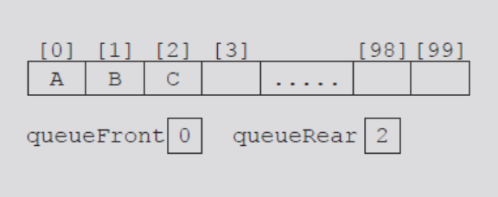
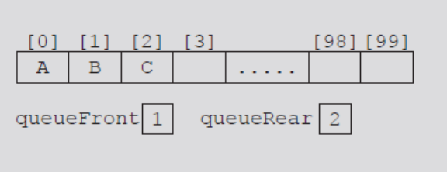
FIGURE 8-1 Queue after the first addQueue operation
FIGURE 8-2 Queue after two more addQueue operations
FIGURE 8-3 Queue after the deleteQueue operation
Data Structures Using C++ 2E

Slide 8
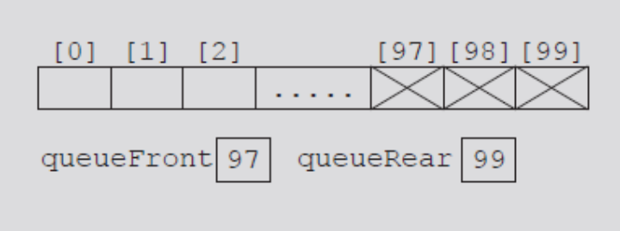
Implementation of Queues as Arrays
(cont’d.)
Consider the sequence of operations: AAADADADADADADADA...
  Eventually index queueRear points to last array position
    Looks like a full queue
    Reality: queue has two or three elements, array empty in the front
FIGURE 8-4 Queue after the sequence
of operations AAADADADADADA...
Data Structures Using C++ 2E

Slide 9
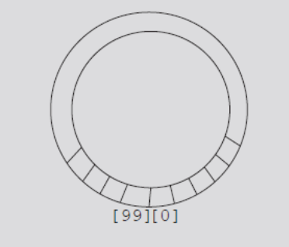
Implementation of Queues as Arrays
(cont’d.)
First solution
  Upon queue overflow to the rear
    Check value of queueFront
    If room in front: slide all queue elements toward first array position
  Works if queue size very small
Second solution: assume circular array
FIGURE 8-5 Circular queue
Data Structures Using C++ 2E

Slide 10
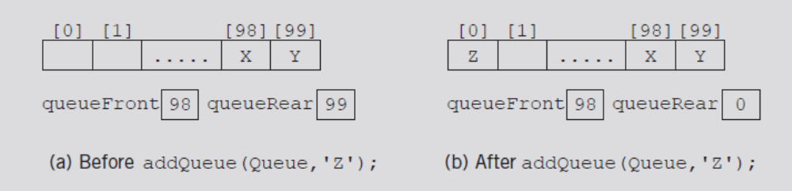
Implementation of Queues as Arrays
(cont’d.)
queueRear = (queueRear + 1) % maxQueueSize;
  Advances queueRear (queueFront) to next array position
FIGURE 8-6 Queue before and after the add operation
Data Structures Using C++ 2E

Slide 11
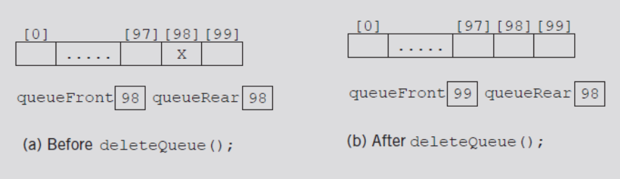
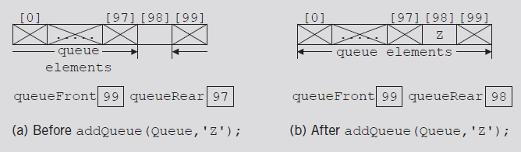
Implementation of Queues as Arrays
(cont’d.)
Two cases with identical queueFront, queueRear values
  Figure 8-7(b) represents an empty queue
  Figure 8-8(b) represents a full queue
FIGURE 8-7 Queue before and after the delete operation
FIGURE 8-8 Queue before and after the add operation
Data Structures Using C++ 2E

Slide 12
Implementation of Queues as Arrays
(cont’d.)
First solution: use variable count
  Incremented when new element added
  Decremented when element removed
  Functions initializeQueue, destroyQueue initialize count to zero
Data Structures Using C++ 2E

Slide 13
Implementation of Queues as Arrays
(cont’d.)
Second solution
  queueFront indicates index of array position preceding first element of the queue
  Assume queueRear indicates index of last element
    Empty queue if queueFront == queueRear
  Slot indicated by index queueFront is reserved
  Queue is full
    If next available space represents special reserved slot
Data Structures Using C++ 2E

Slide 14
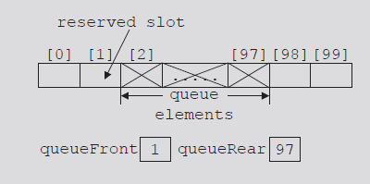
Implementation of Queues as Arrays
(cont’d.)
FIGURE 8-9 Array to store the queue
elements with a reserved slot
Data Structures Using C++ 2E

Slide 15
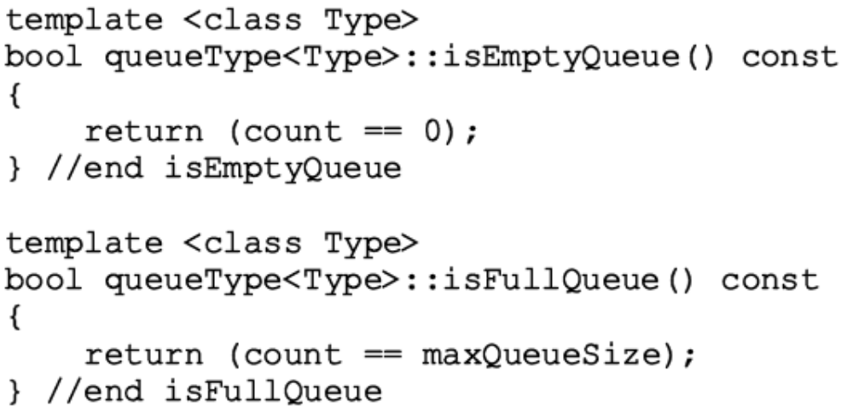
Empty Queue and Full Queue
Empty queue
  If count == 0
Full queue
  If count == maxQueueSize
Data Structures Using C++ 2E

Slide 16
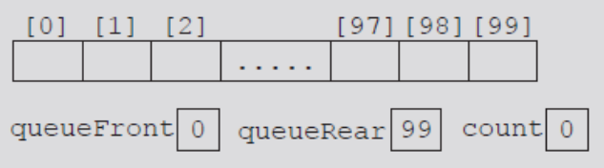
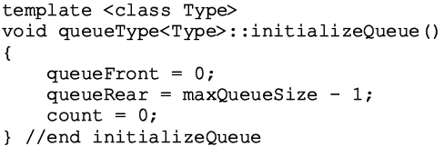
Initialize Queue
Initializes queue to empty state
  First element added at the first array position
  Initialize queueFront to zero, queueRear to maxQueueSize - one, count to zero
FIGURE 8-10 Empty queue
Data Structures Using C++ 2E

Slide 17
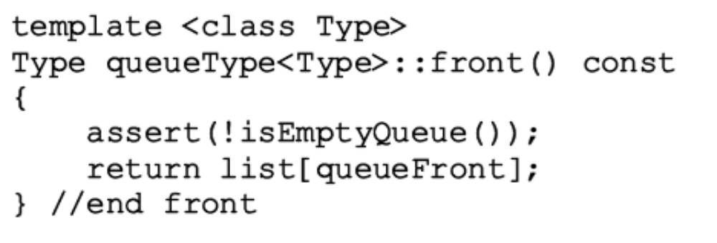
Front
Returns first queue element
  If the queue nonempty
    Element indicated by index queueFront returned
  Otherwise
    Program terminates
Data Structures Using C++ 2E

Slide 18
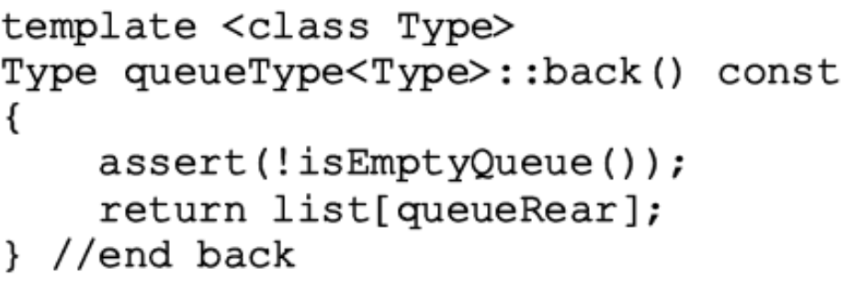
Back
Returns last queue element
  If queue nonempty
    Returns element indicated by index queueRear
  Otherwise
    Program terminates
Data Structures Using C++ 2E

Slide 19
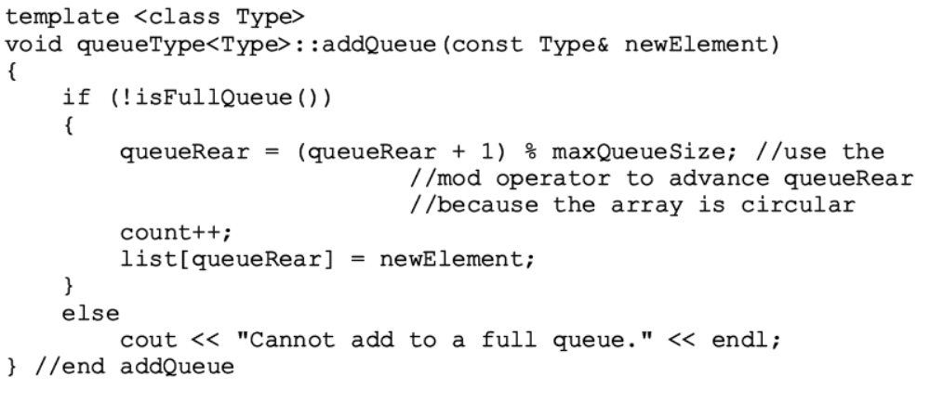
Add Queue
Data Structures Using C++ 2E

Slide 20
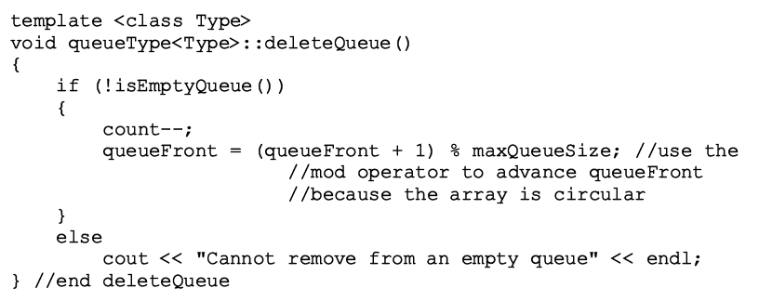
Delete Queue
Data Structures Using C++ 2E

Slide 21
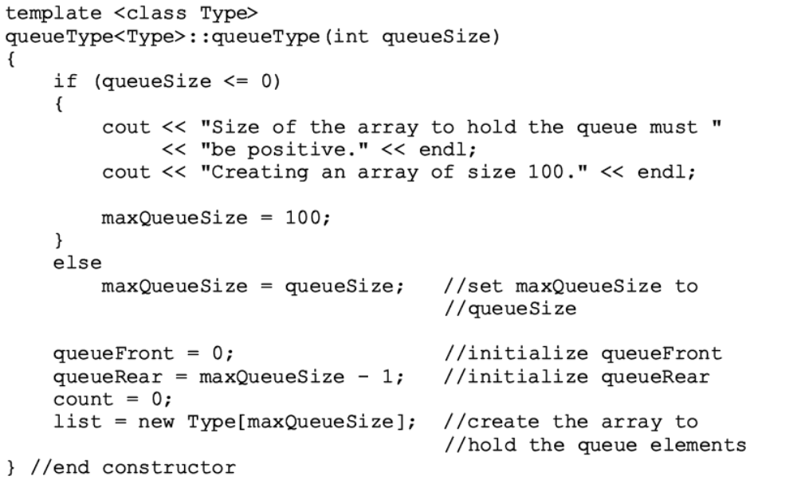
Constructors and Destructors
Data Structures Using C++ 2E

Slide 22
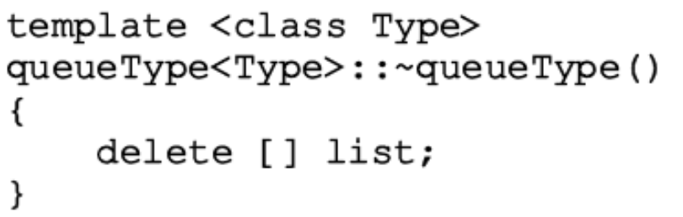
Constructors and Destructors (cont’d.)
  When queue object goes out of scope
    Destructor deallocates memory occupied by the array storing queue elements
Data Structures Using C++ 2E

Slide 23
Linked Implementation of Queues
Array implementation issues
  Fixed array size
    Finite number of queue elements
  Requires special array treatment with the values of the indices queueFront, queueRear
Linked implementation of a queue
  Simplifies special cases of the array implementation
  Queue never full
Data Structures Using C++ 2E

Slide 24
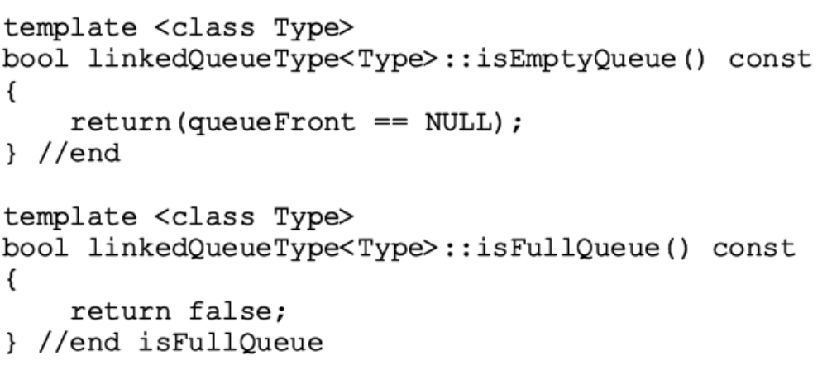
Empty and Full Queue
Empty queue if queueFront is NULL
Memory allocated dynamically
  Queue never full
  Function implementing isFullQueue operation returns the value false
Data Structures Using C++ 2E

Slide 25
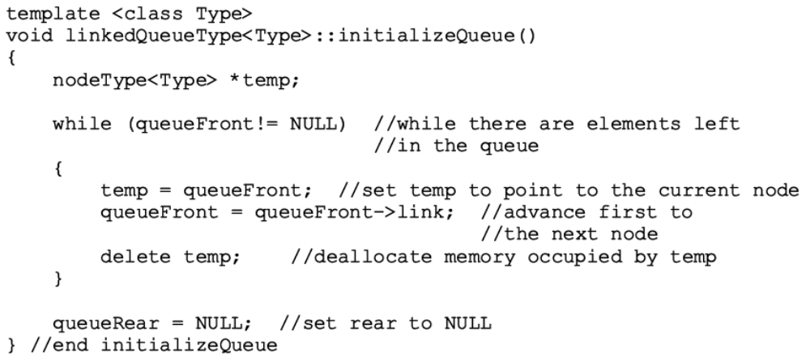
Initialize Queue
Initializes queue to an empty state
  Empty if no elements in the queue
Data Structures Using C++ 2E

Slide 26
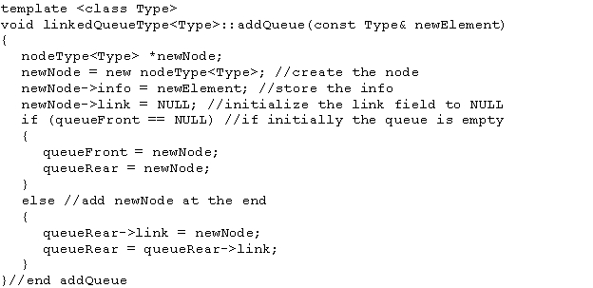
addQueue, front, back, and deleteQueue Operations
addQueue operation adds a new element at end of the queue
  Access the pointer queueRear
Data Structures Using C++ 2E

Slide 27
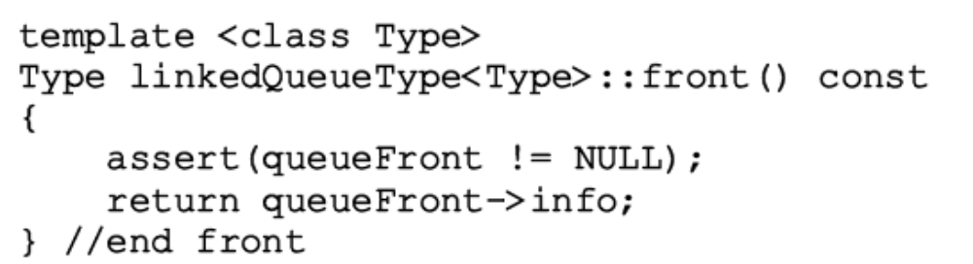
addQueue, front, back, and deleteQueue Operations (cont’d.)
If queue nonempty
  Operation front returns first element
  Element indicated queueFront returned
If queue empty: front terminates the program
Data Structures Using C++ 2E

Slide 28
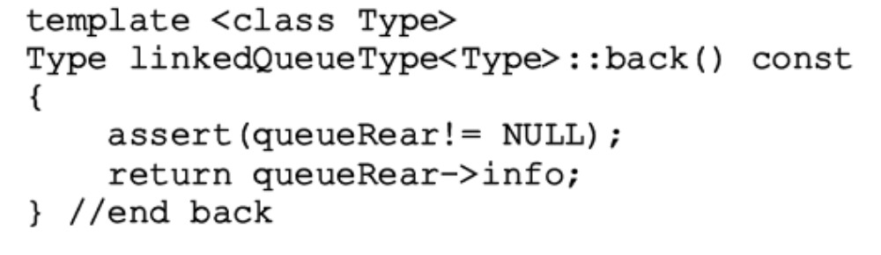
addQueue, front, back, and deleteQueue Operations (cont’d.)
If queue nonempty
  Operation back returns last element
  Element indicated by queueRear returned
If queue empty: back terminates the program
Data Structures Using C++ 2E

Slide 29
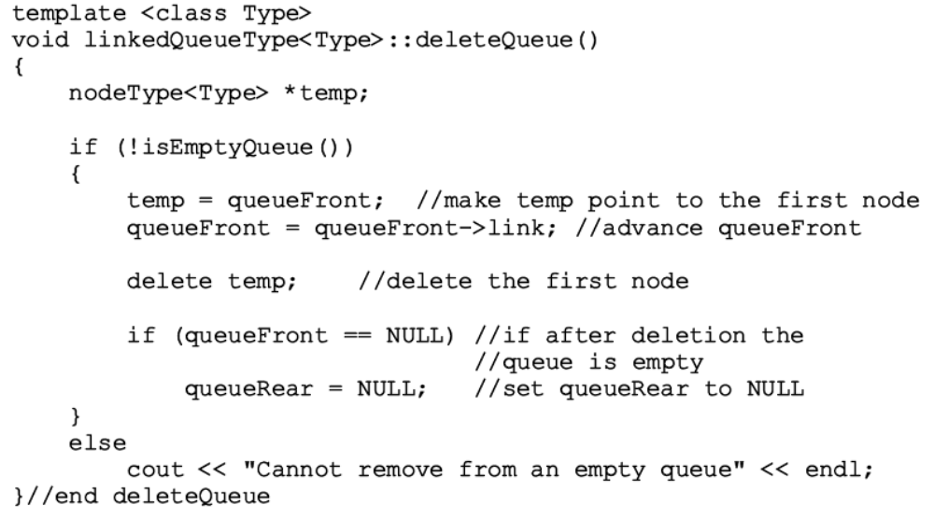
addQueue, front, back, and deleteQueue Operations (cont’d.)
If queue nonempty
  Operation deleteQueue removes first element
    Access pointer queueFront
Data Structures Using C++ 2E

Slide 30
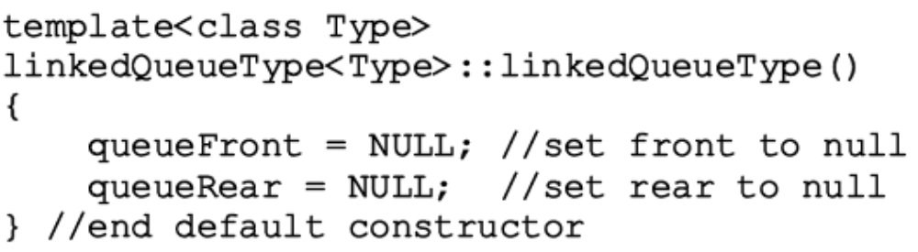
addQueue, front, back, and deleteQueue Operations (cont’d.)
Default constructor
  When queue object goes out of scope
    Destructor destroys the queue
    Deallocates memory occupied by the queue elements
  Function definition similar to function initializeQueue
Data Structures Using C++ 2E

Slide 31
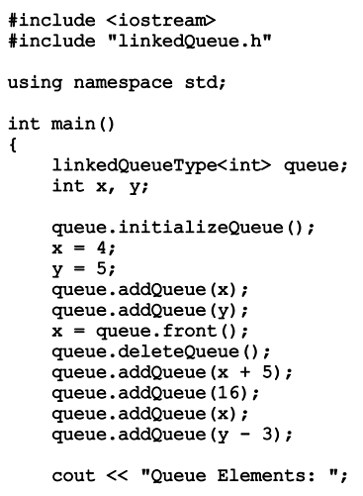
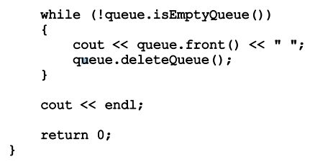
class linkedQueue (Example)

Slide 32
STL class queue (Queue Container Adapter)
Standard Template Library (STL)
  Provides a class to implement queues in a program
  Queue
    Name of class defining the queue
    Name of header defining class queue
Data Structures Using C++ 2E

Slide 33
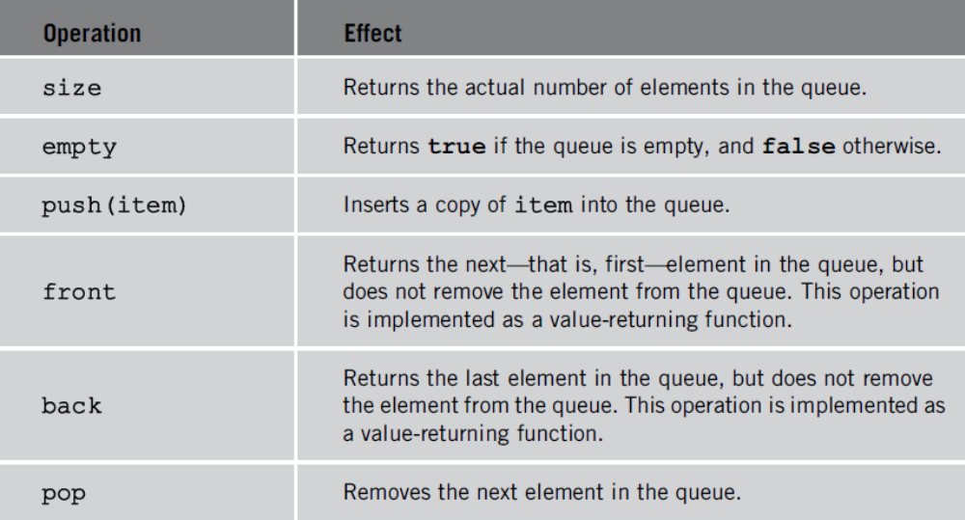
STL class queue (cont’d.)
Queue container class
  Provides relational operators comparing two queues
TABLE 8-1 Operations on a queue object
Data Structures Using C++ 2E

Slide 34
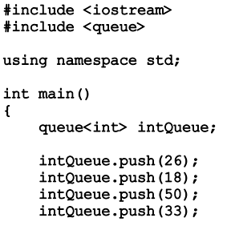
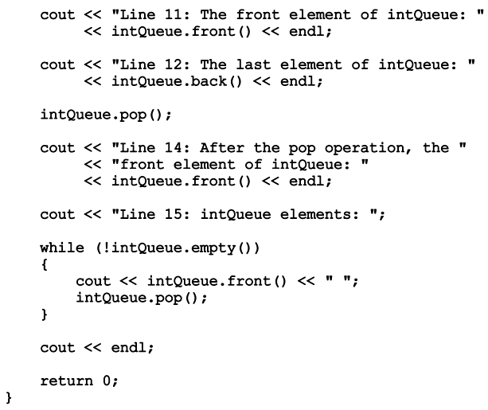
STL

Slide 35
Priority Queues
Queue structure ensures items processed in the order received
Priority queues
  Customers (jobs) with higher priority pushed to the front of the queue
Implementation
  Ordinary linked list
    Keeps items in order from the highest to lowest priority
  Treelike structure
    Very effective
    HEAP
Data Structures Using C++ 2E

Slide 36
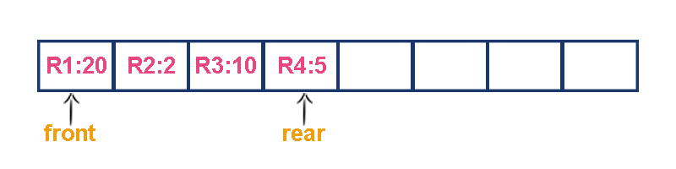
Priority Queue
Consider a networking application where server has to respond for requests from multiple clients using queue data structure.
Assume four requests arrived to the queue in the order of
R1 requires 20 units of time,
R2 requires 2 units of time,
R3 requires 10 units of time
R4 requires 5 units of time. Queue is as follows...

Slide 37
Priority Queue
Now, check waiting time for each request to be complete.
R1 : 20 units of time
R2 : 22 units of time
R3 : 32 units of time
R4 : 37 units of time
Here, average waiting time for all requests (R1, R2, R3 and R4) is
(20+22+32+37)/4 ≈ 27 units of time.

Slide 38
Priority Queue
If we serve according to their required amount of time.
That means, first we serve R2 which has minimum time required (2)
then serve R4 which has second minimum time required (5)
then serve R3 which has third minimum time required (10)
and finally R1 which has maximum time required (20).

Slide 39
Priority Queue
Now, check waiting time for each request to be complete.
R2 : 2 units of time
R4 : 7 units of time
R3 : 17 units of time
R1 : 37 units of time
Here, average waiting time for all requests (R1, R2, R3 and R4) is
(2+7+17+37)/4 ≈ 15 units of time.

Slide 40
Priority Queue
From above two situations, it is very clear that, by using second method server can complete all four requests with very less time compared to the first method. This is what exactly done by the priority queue.
A (regular) queue has first-in, first-out (FIFO) behaviour, where
items must enter at the rear and leave from the front.
In a priority queue items must leave from the front, but they
enter on the basis of a priority (key) value. The queue is kept sorted by this value.

Slide 41
Priority Queue
Examples of Priority Queues
CPU process queues
Print queues
Event-driven simulation (traffic flows)
VLSI design (channel routing, pin layout)
Artificial intelligence search algorithms

